Slide 1
Fine tuning LLMs on Gretel's synthetic text-to-sql dataset
Models used- Meta-LLama-1B and DeepSeek-R1-1.5B
Siddharth Dumbre

Slide 2
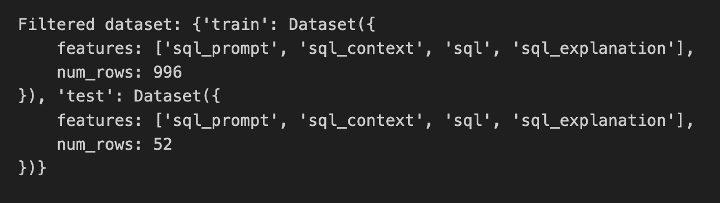
Dataset Overview
Source: Gretel's synthetic text-to-SQL dataset
Domain: Filtered for "Wildlife Conservation"
Structure:
Input:
Instruction: Natural Language Query
Context: Database Schema
Output:
Response: SQL Query
Explanation: Description of SQL query

Slide 3

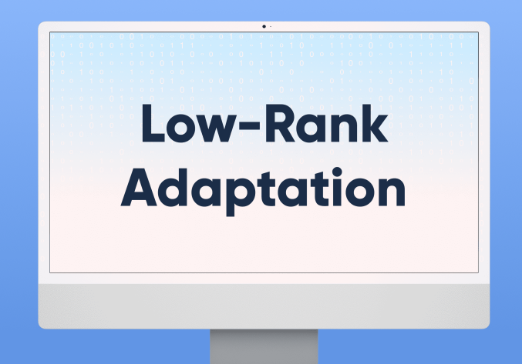
Training Configuration
num_train_epochs=3,
per_device_train_batch_size=2,
gradient_accumulation_steps=16,
learning_rate=2e-4,
fp16=True,
logging_steps=10,
save_steps=200,
LoRA for parameter-efficient fine-tuning

Slide 4
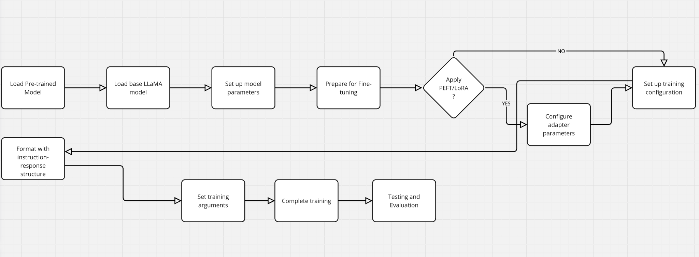
Workflow

Slide 5
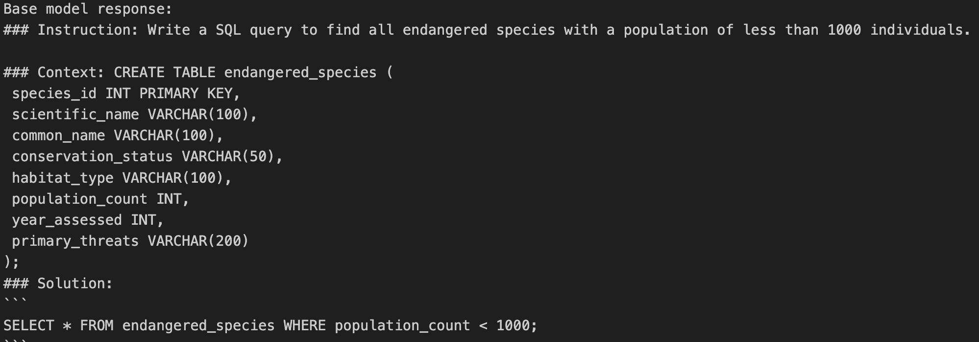
Baseline Performance
For a simple prompt, both the models provided the same output query
Meta llama provided a generic response despite the context provided
Meta Llama Response:

Slide 6
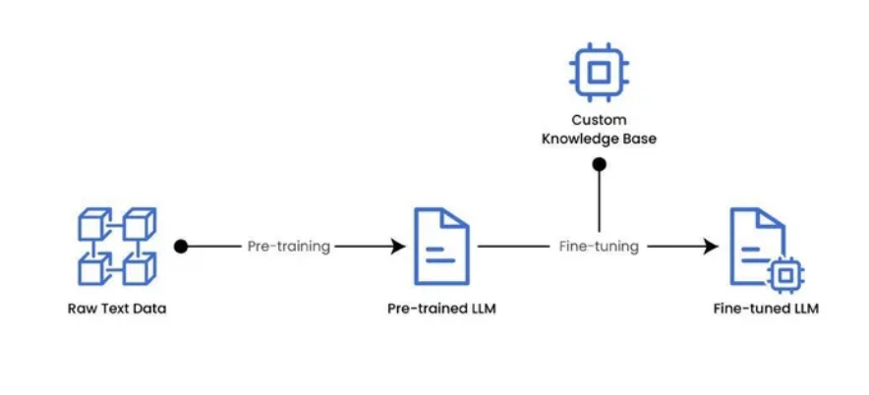
Fine-Tuning Process
Training parameters:
Epochs: 3
Batch Size: 2
Learning Rate: 2e-4
Max Sequence Length: 512
Trainer: SFTTrainer (Transformers RL)
LoRA applied for lightweight tuning
Dataset tokenized and batched
Gradual learning rate adjustments
Model checkpoints saved every 200 steps

Slide 7
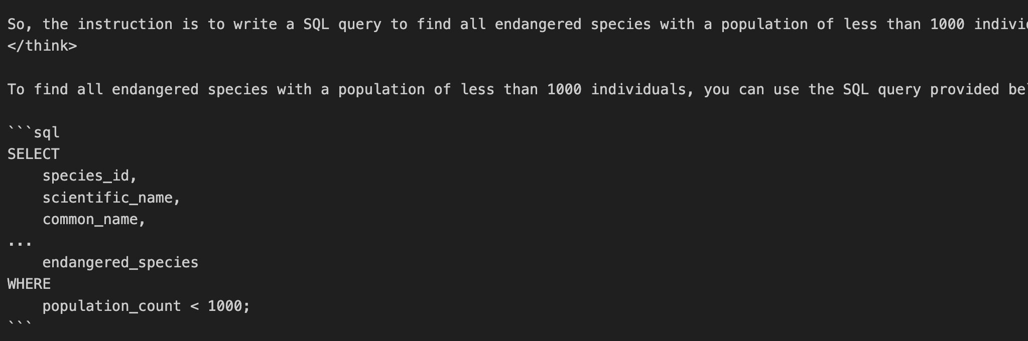
Baseline Performance
Deepseek showed some reasoning abilities in addition to generating the prompt
It gave a generic response but provided all the fields present in the context
Deepseek Response:

Slide 8
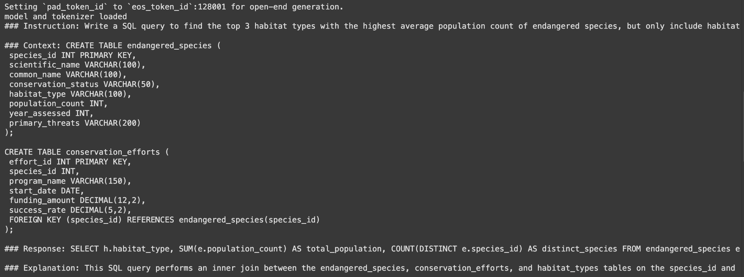
Post-Fine-Tuning Performance
After fine tuning, both the models provided optimized query with respect to the context provided
Meta Llama output: provided similar output to test results

Slide 9
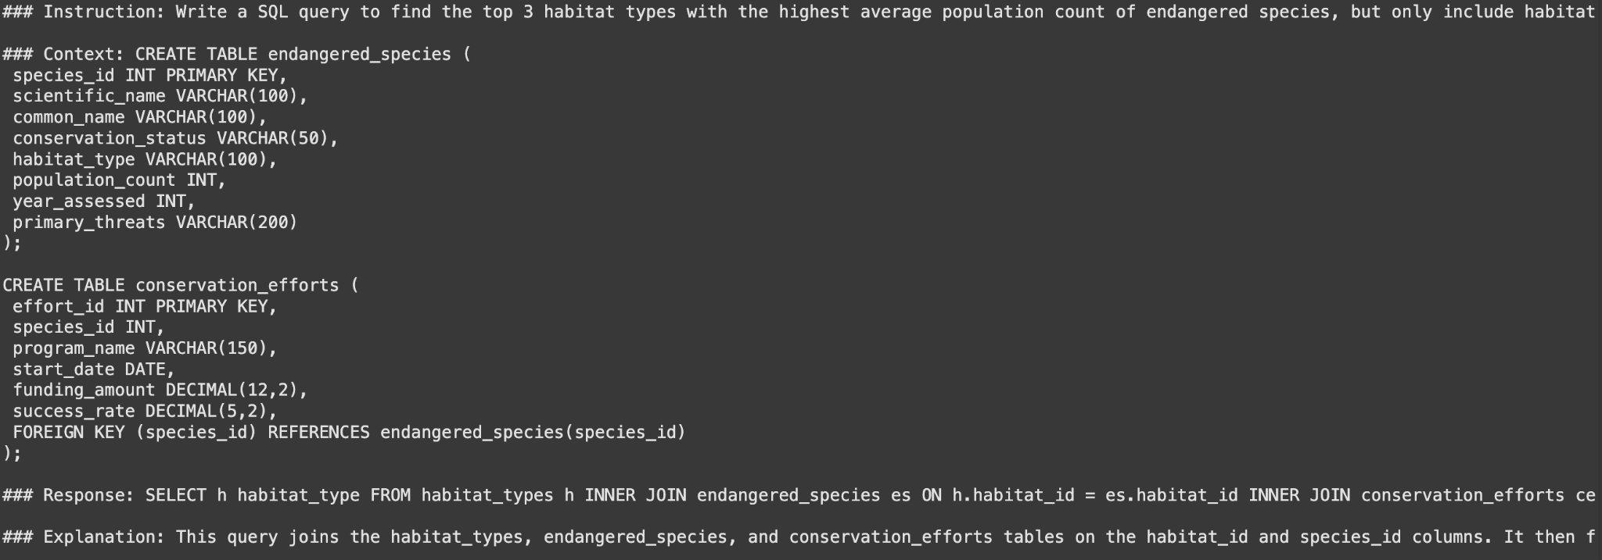
Post-Fine-Tuning Performance
Deepseek Output: provided optimized query

Slide 10
Results (DeepSeek vs. LLaMA Post-Fine-Tuning)
Common Query: Which habitats have seen a decrease in preservation efforts from 2017 to 2018?
LLama Response: SELECT Habitat, Year, Efforts FROM PreservationTrends WHERE Efforts < (SELECT SUM(Efforts) FROM PreservationTrends WHERE Year = 2018);
DeepSeek Response: SELECT Habitat FROM PreservationTrends WHERE Year = 2017 AND Efforts < (SELECT SUM(Efforts) FROM PreservationTrends WHERE Year = 2018 AND Habitat = Habitat);

Slide 11
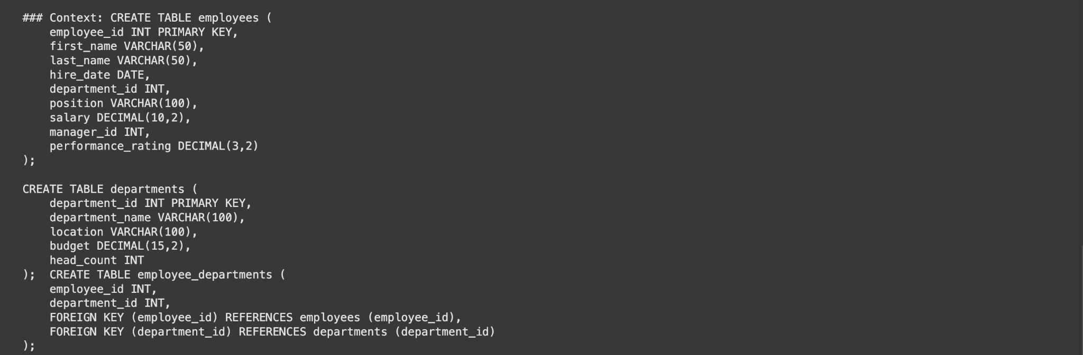
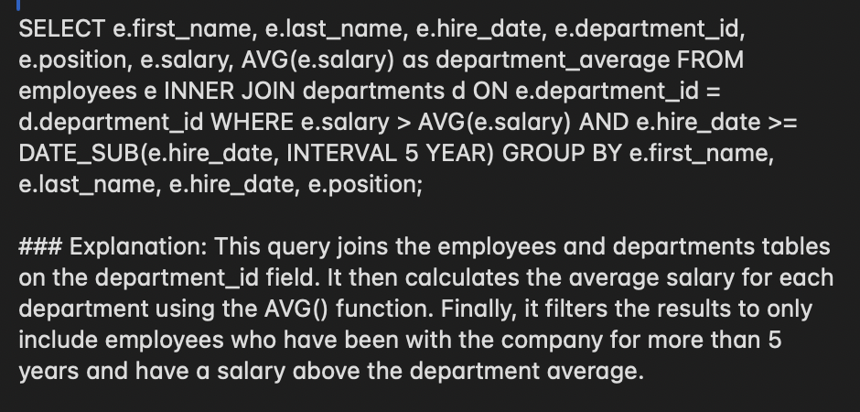
Observations
Deepseek provides an optimized and efficient queries involving multiple tables
Instruction:: Write a SQL query to find all employees who have been with the company for more than 5 years and have a salary above the department average.
Correct Joins and Group BYs

Slide 12
Summary of findings:
Fine-tuning significantly improves SQL accuracy
LoRA is effective for parameter-efficient tuning
Llama was trained with a training loss of 0.4 while deepseek was trained with training loss of 0.5, however there was a significant number in the trained parameters of base model
When it comes to testing on a data with mathematical and logical complexity, deepseek outperforms Meta-Llama in terms of rightness and optimization

Slide 13
THANK YOU

